Slide 1
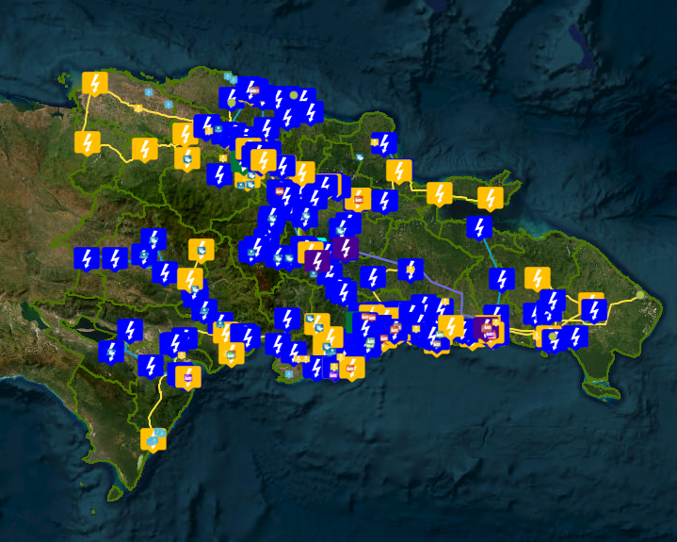
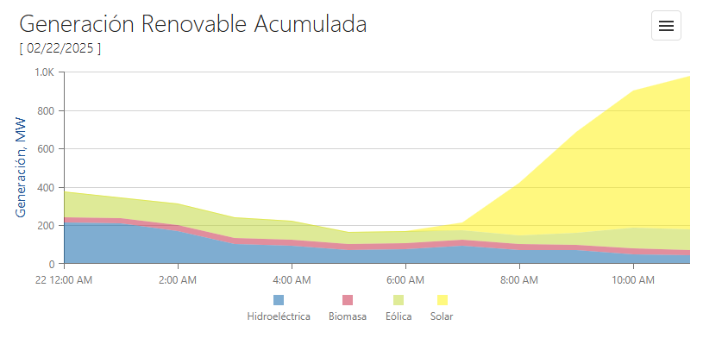
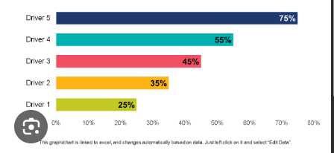
SENI Real Time
Renewable Energy Prediction hourly
Future Plan Prediction
Gen tiempo real
Unidad Marginal
Real
Programada
Gen acumulada por planta por dia
Gen por planta

Slide 2
SENI Real Time
Renewable Energy Prediction hourly
Future Plan Prediction
Gen Solar global RT
Gen Eolica global RT
Gen programada
Gen prediction
Solar 1 - Gen
Solar 1 - programada
Solar 1 - prediction
Solar 2 - Gen
Solar 2 - programada
Solar 2 - prediction
Solar 2 - Gen
Solar 2 - programada
Solar 2 - Gen
Solar 2 - programada

Slide 3
SENI Real Time
Renewable Energy Prediction
Future Plan Prediction

